Slide 1
Obfuscation
Fingerprinting
In Android Binaries
Matt Van Veldhuizen

Slide 2
Overview
Introduction to Obfuscation
Introduction to Deobfuscation
Introduction to Android
Obfuscation Methods on Android
Obfuscation Programs for Android
Looking at Obfuscation Fingerprints
Looking into the Future
Questions

Slide 3
Introduction to Obfuscation
The deliberate act of creating obfuscated code
Source or Machine Code that is difficult for humans to understand
Some languages are easier to obfuscate
C/C++/Perl

Slide 4
Benefits of Obfuscation
Can Create Smaller Files
Hide Company Secrets
Hide Copyright Management
DRM
Harder to Reverse Engineer

Slide 5
Introduction to Deobfuscation
To Convert a program that is difficult to understand into that is simple to understand

Slide 6
Benefits of Deobfuscation
Investigation of malware
Discovering the true intent of the malware
Discovering the C&C server of the malware
etc...
Recover lost source code

Slide 7
Introduction To Android
Open Source OS for mobile, embedded and wearable devices
Based off Linux
Uses Dalvik VM with JIT compilation to run Dalvik executable (dex-code)
dex-code is usually translated from the Java Bytecode

Slide 8
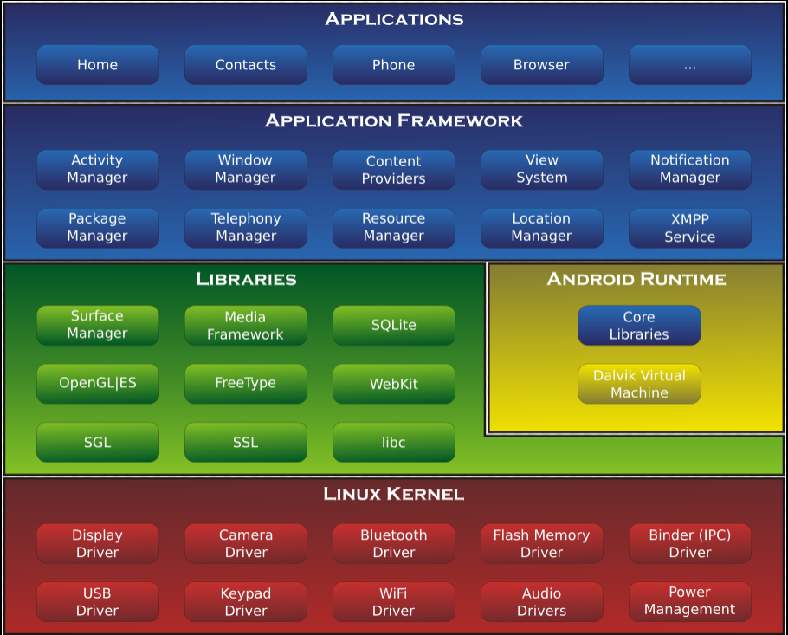
Introduction To Android
http://en.wikipedia.org/wiki/Android_(operating_system)

Slide 9
Introduction To Android
Java Source Code
Java Source Code
Java Compiler
Java Compiler
Java Bytecode
Java Bytecode
Dex Compiler
Dalvik Bytecode
Java Byte Code
Dalvik Executable
Java VM
Dalvik VM

Slide 10
Introduction To Android
Application Packages
.apk files: compressed files
class byte code
resources (icons, sounds, etc)
Binary native files

Slide 11
Introduction To Android
Defines the metadata
i.e. requested permissions or registered services and activities
Activities are screens that allow the user to interact with the program
i.e. dial the phone, take a photo, send an email
Each is given a window (floating or full screen)
<manifest xmlns:android="http://schemas.android.com/apk/res/android" ... >
<uses-sdk android:minSdkVersion="8" android:targetSdkVersion="19" />
...
</manifest>

Slide 12
Obfuscation Methods on Android
Identifier Renaming
Junk Byte Insertion
Obfuscated/Encrypted Strings
Dynamic Code Modification
Call Graph Obfuscation
Manifest Obfuscation

Slide 13
Obfuscation: Identifier Renaming
Variable/Function Name Change
public class Base64 {
public String decode( String input )
{ … }
public String encode( String input )
{ … }
}
public class a {
public String a( String a)
{ … }
public String b( String b)
{ … }
}
Java Source Code
Java Source Code With Renamed Identifiers

Slide 14
Obfuscation: Junk Byte Insertion
Junk Instructions have to be incorrect (i.e. incomplete)
Produces a red herring for disassemblers
Junk Instructions must never be reached
Prevented with an unconditional jump before junk instructions

Slide 15
Obfuscation: Junk Byte Insertion
0003bc: 1250 | 0000: const / 4 v0, #int 5
0003be: 2900 0400 | 0001: goto / 16 0005
0003c2: 0001 | 0003: <junkbytes>
0003c4: 0000 | 0004: <junkbytes>
0003c6: d800 000 | 0005: add-int / lit8 v0, v0, #int 1
0003ca: 0f00 | 0007: return v0
Disassembly with detection of Junk Bytes
0003bc: 1250 | 0000: const / 4 v0, #int 5
0003be: 2900 0400 | 0001: goto / 16 0005
0003c2: 0001 0000 d800 0001 | 0003: dummy-function
0003ca: 0f00 | 0007: return v0
Linear Sweep with dexdump fails due to junk bytes

Slide 16
Obfuscation: Junk Byte Insertion
0003bc: 1250 | 0000: const / 4 v0, #int 5
0003be: 2900 0400 | 0001: if-gtz v0, 0005
0003c2: 0001 0000 d800 0001 | 0003: dummy-function
0003ca: 0f00 | 0007: return v0
Recursive Traversal fails due to conditional branches

Slide 17
Obfuscation: Encrypting Strings
The Use of encryption to render strings unreadable
Strings are Stored encrypted inside the application
Strings are decoded/decrypted during runtime
public void init () {
String host = "www.example.com";
String username = "secretuser";
String password = "secretpass";
}
public void init () {
String host = decrypt("fbe84eae33e4efdb637a");
String user = decrypt("a58be63b1602ab2a6ac2");
String pass = decrypt("a0133dc939c4f54571fa");
}
Java Source with unencrypted strings
Java Source with encrypted strings

Slide 18
Obfuscation: Dynamic Load Code
Loading Remote Code into Memory
Library Functions already provided
java.net.url
Loading and Execution are possible through the standard DexFile class (manipulates dex files - provides random read access to dex files)

Slide 19
Obfuscation: Code Modification
Increases the difficulty of static analysis
Dalvik Code
Native Code

Slide 20
Code Modification: Dalvik Code
Dalvik Bytecode has limited instruction set
Not possible to alter the bytecode dynamically
Need an external helper like the Java Native Interface (JNI)
Enables Java code running in a JVM to call and be called by native applications (programs specific to hardware or os) and libraries in other languages (c/c++/assembly)

Slide 21
Code Modification: Dalvik Code
Using JNI it can execute native code in the context of the current running processes allowing it access to memory
The new code will further be executed by the DVM

Slide 22
Code Modification: Native Code
Native Code that is executed directly by the processor
This method works very similar to dynamic code manipulation on x86 machines

Slide 23
Obfuscation: Call Graph
Android programs start from a fork of the zygote process
Includes a set of preloaded libraries
Android Framework
Classes in the application have the same name as the preloaded libraries
The bytecode then points the the APK-internal definition but during runtime the preloaded definitions will be used

Slide 24
Obfuscation: Manifest
Static analysis tools can be exploited by using an attribute with an invalid ID
<manifest xmlns:android="http://schemas.android.com/apk/res/android"
package=0x00000000
android:sharedUserId="string"
android:sharedUserLabel="string resource"
android:versionCode="integer"
android:versionName="string"
android:installLocation=["auto" | "internalOnly" | "preferExternal"] >
. . .
</manifest>

Slide 25
Obfuscation Programs on Android
ProGuard
JODE
jarg
JBCO
ClassEncrypt
Zelix KlassMaster

Slide 26
Obfuscation Program: ProGuard
Shrinks/Optimizes/ Obfuscates
removing unused code
renaming classes/fields/methods
Integrated into the Android Build System
Creates a definition file describing how it obfuscates
Creates a mapping file after renaming

Slide 27
Obfuscation Program: JODE
Renamed Class/Method/field/local names
Removes debugging info
removes dead code
optimizes local variable allocation
Java Optimize and Decompile Environment

Slide 28
Obfuscation Program: jarg
Removes:
debugging info
unnecessary attributes
unused entries in the constant pool
unused fields, methods, classes, interfaces
Renames:
field, method with private access restrictions
field, method, class, interface default access restrictions
Bytecode Optimization:
Removes NOP instructions
Compressing local variable slots
Java Archive Grinder

Slide 29
Obfuscation Program: JBCO
Uses Soot: Java Optimization framework
packages local variables into bitfields
replaces if(non)null instructions with try-catch
adds dead-code switch statements
finds and reuses duplicate sequences
Converts branches to jsr instructions
Indirecting if instructions
reorders load instructions
renames identifiers
disobeys constructor conventions
goto instruction augmentation
Java ByteCode Obfuscator

Slide 30
Obfuscation Program: ClassEncrypt
Encrypts class files to prevent string identification

Slide 31
Obfuscation Program: KlassMaster
Java Obfuscator But has built-in support for Android
Features
Name Obfuscation
Flow Obfuscation
Exception Obfuscation
String Encryption
Line Number Scrambling
AutoReflection
Handles Java’s Reflection API calls
Reflection allows for calling classes, fields, methods by name
Issue with Name Obfuscation
Trim
Remove Unused Classes, fields, methods

Slide 32
Looking at Obfuscation Fingerprints
There are a lot of different obfuscators and deobfuscators
Each with their own way of doing things

Slide 33
Looking at Obfuscation Fingerprints
Is there a way to determine which obfuscation program/method was used on the program/code and suggest a possible deobfuscation program/method to use

Slide 34
Looking at Obfuscation Fingerprints
If not can we determine based on the type of obfuscation what any particular section of code is doing
i.e. Networking, I/O operation

Slide 35
Past Research
elucidate
Java Obfuscator Fingerprinting/Cracking Tool
By Yiannis Pavlosoglou
Only Information from DEFCON 15
What it Does
Given a jar/class file
Identify which obfuscator has been used
Recover Known strings within the file
Give an estimate of the complexity
Provide a map of the application

Slide 36
Looking into the Future
November 2014
Install Android SDK + Obfuscation Programs
December 2014
Write android app(s) + find commercial obfuscated app
Obfuscate the written app with the obfuscators mentioned earlier
Look at the differences between the obfuscated code
January 2015
Look at fingerprints in commercial app

Slide 37
Looking into the Future
February 2015
Give Second Presentation
Write a program that can identify fingerprints
And suggest a deobfuscator that would work best
April 2015
Give Final Presentation
Finish Project Write Up

Slide 38
Questions?

Slide 39
Sources
ClassEncypt - http://classencrypt.sourceforge.net/
JBCO - http://www.sable.mcgill.ca/JBCO/examples.html
jarg - http://jarg.sourceforge.net/
JODE - http://jode.sourceforge.net/
ProGuard - http://proguard.sourceforge.net/
elucidate - https://www.defcon.org/images/defcon-15/dc15-presentations/dc-15-subere.pdf
Wikipedia - http://en.wikipedia.org/wiki/Android_(operating_system)
Into to Android - http://web.stanford.edu/class/cs231m/docs/intro-to-android-dev.pdf
Zelix Klass Master - http://www.zelix.com/klassmaster/featuresIncrementalObfuscation.html

